Slide 1
Breakout activity – Text Mining
In your groups –
https://towardsdatascience.com/machine-learning-text-processing-1d5a2d638958
Connect to this data set –Corona_NLP_test.csv
Print in descending order the most used words
Stretch Work -Create a word cloud

Slide 2
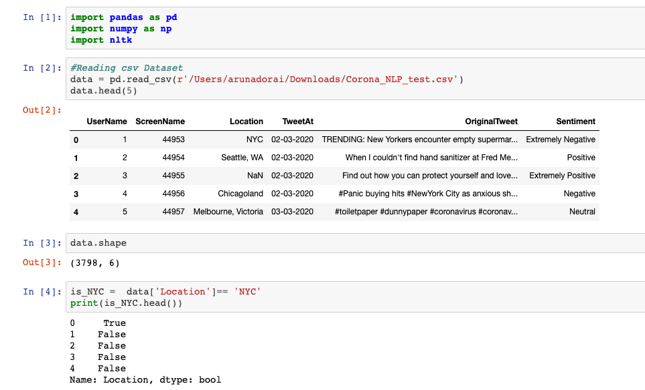
Code snippet

Slide 3
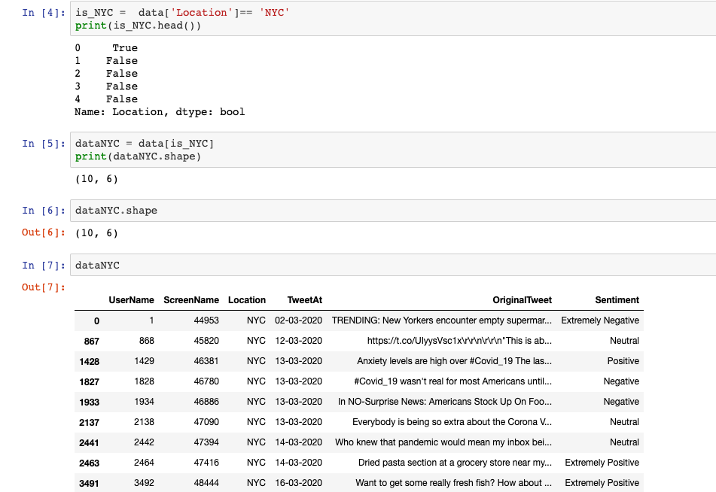
Code Snippet –contd 1

Slide 4
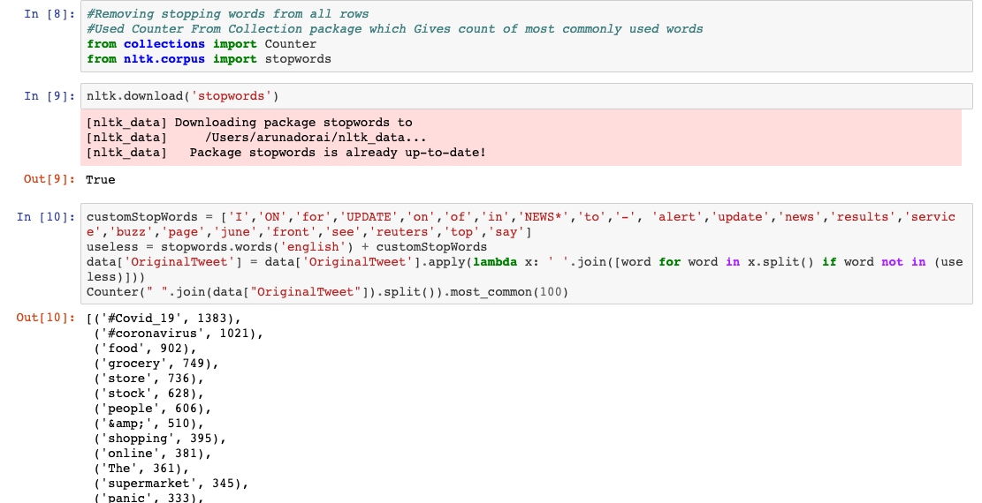
Code Snippet –Contd -2

Slide 5
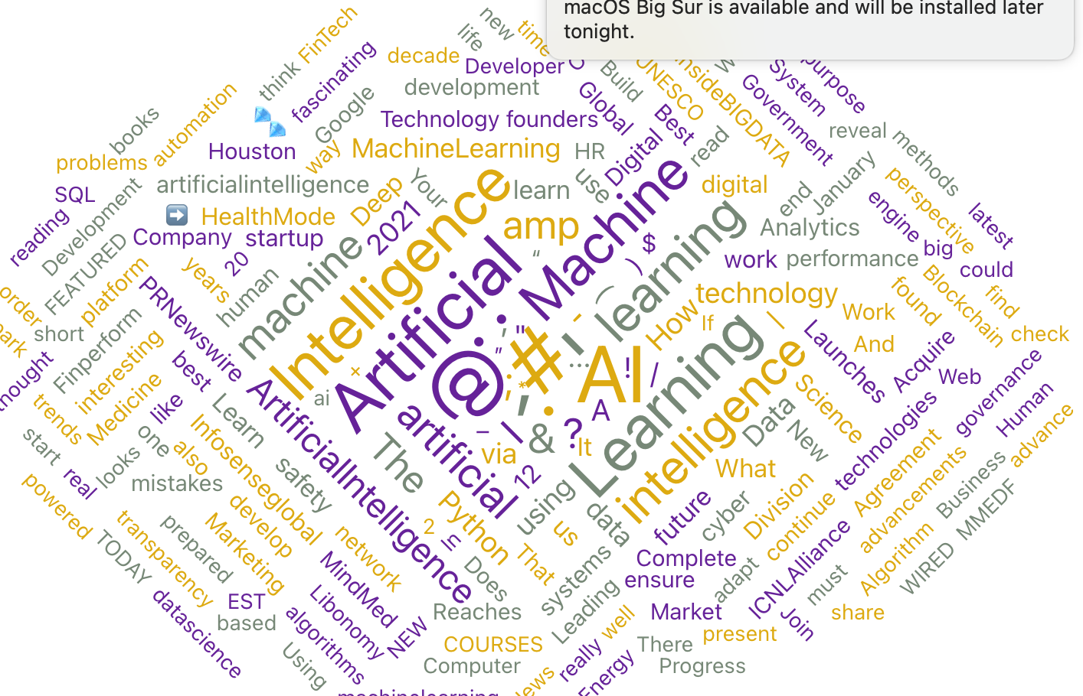

Slide 6
References
https://www.nltk.org/
https://programminghistorian.org/en/lessons/counting-frequencies

